Slide 1
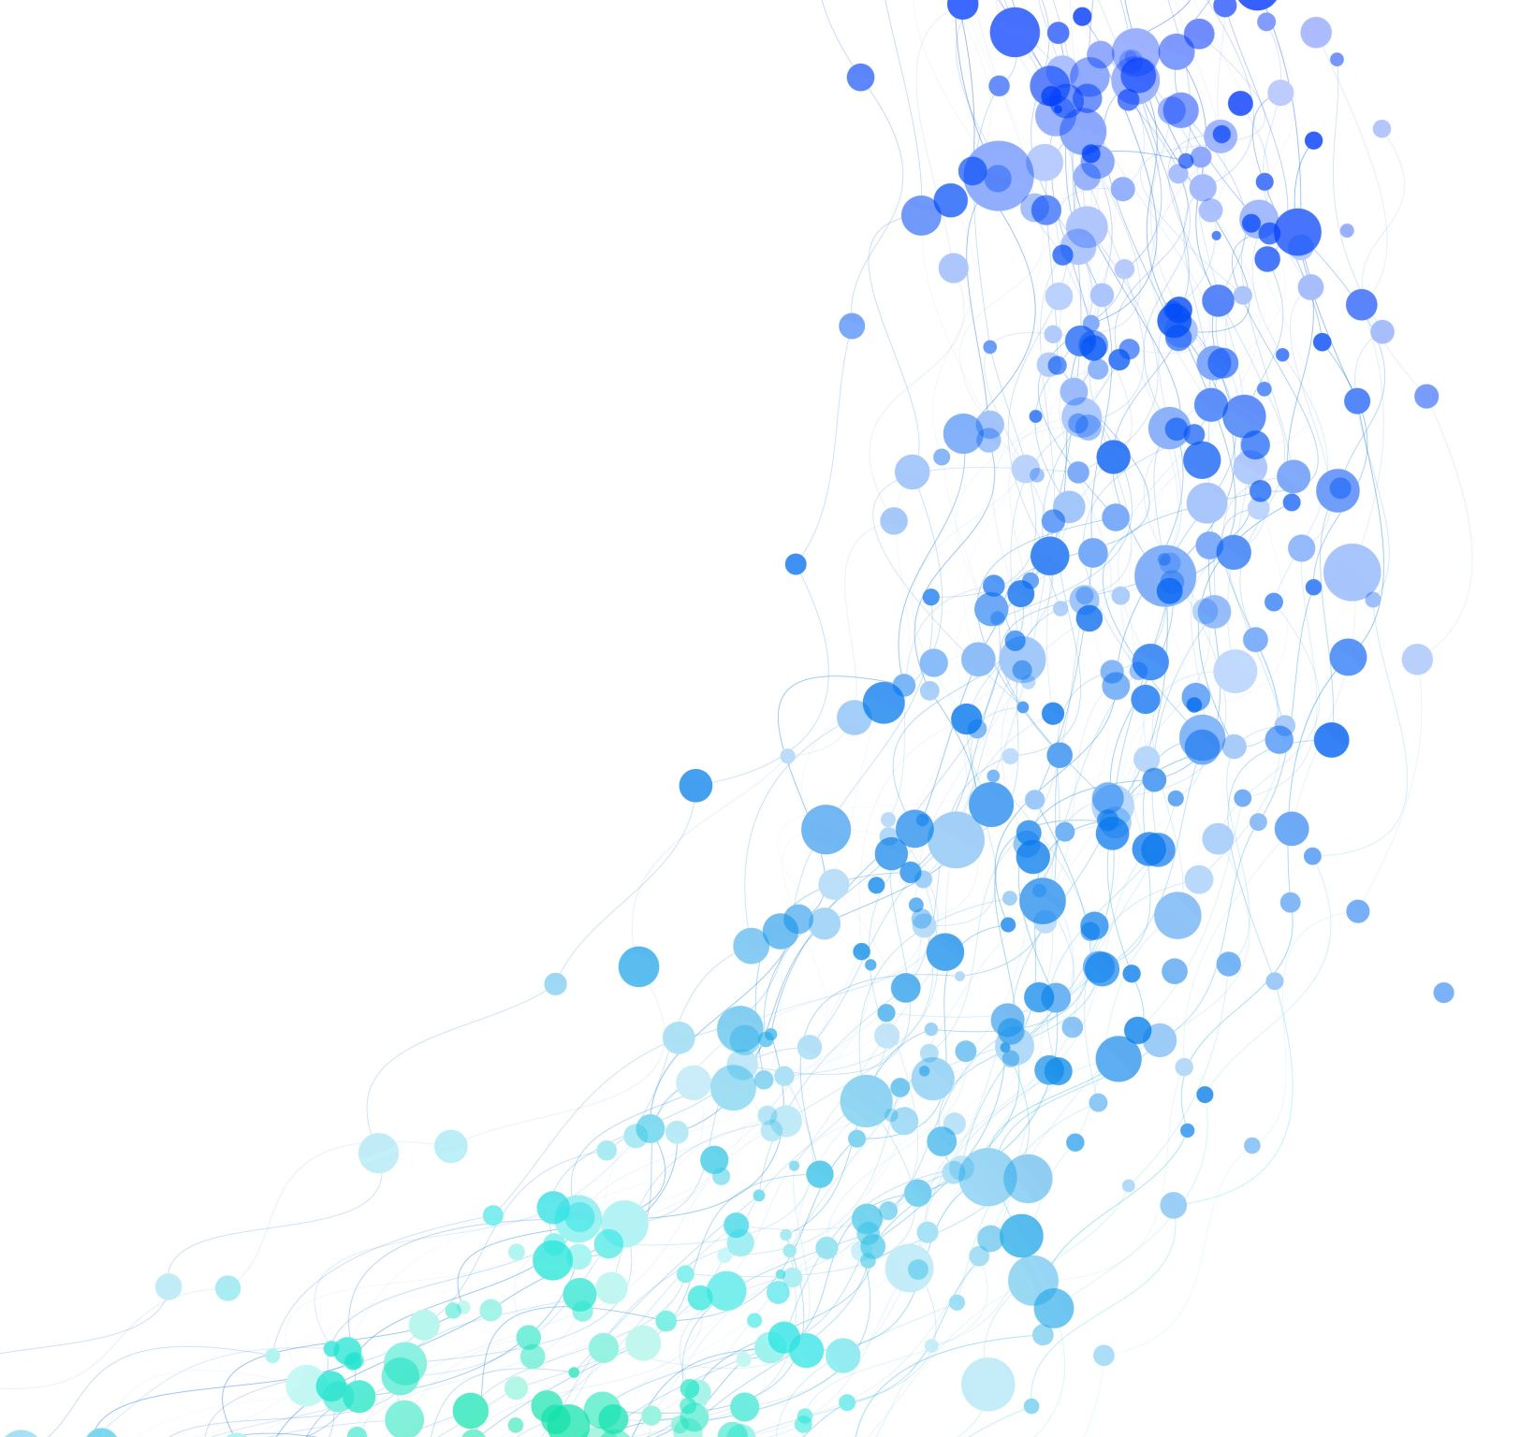
Many Body Post-Minkowski Simulation
Zackary Windham
Advisor: Dr. Neilsen

Slide 2
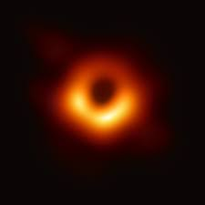
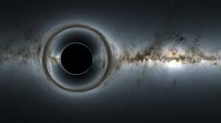
General Relativity And Black Holes
M87 Galactic Center
Credit: Nasa
Notes:
General relativity describes gravity as the curvature of space-time
It allows for some weird effects like the bending of light and time.
Black hole are predicted by the equations of general relativity; the image on the right is an imaged black hole.

Slide 3
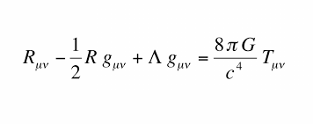
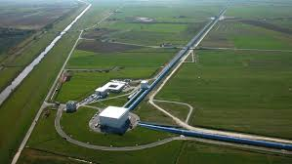
Gravitational Waves
Credit: NASA
ligo.caltech.com
Notes:
Large objects moving through space-time produce gravitational waves; ripples in space-time.
Because we can’t really detect black holes with light like we can with stars, gravitational waves are a to observe black holes and study them from the information these waves give us.
LIGO was built to detect gravitational waves; however, it needs to know what it’s looking for.
We can use the equations of GR to simulate what a black hole binary merger would look like and thus to predict what the gravitational waveform would look like.
However there are millions of different potential merger scenarios, that all have different waveforms. So LIGO needs an archive of templates to which it can match what it detects and see if it fits any theoretical gravitational waveforms.
More slides here; roughly one slide per minute.
Mention later detections of gravitational waves as well; include stellar graveyard graphic.
Takes two months to run a code at the production level needed to analyze GW.
Motivate having a template library more.

Slide 4
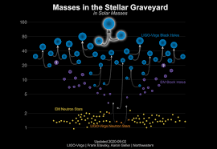
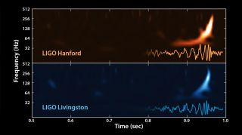
Black Hole Observatory
https://www.space.com/31894-gravitational-waves-ligo-search-complete-coverage.html
https://www.ligo.caltech.edu/image/ligo20200902a
Notes:
The first gravitational waves were detected back in 2015; their waveform is shown here.
It was a merger of two black holes
Since then, LIGO has observed many different mergers of stellar remnants that we’ve been able to study. Shown is a diagram of masses in the stellar graveyard, which is called that due to the fact that the neutron stars and black hole merging are remnants of dead stars. Most of the objects in this diagram were detecting using gravitational wave observation since 2015.
The simplest way for a black hole binary to occur is if the two black holes formed in situ, essentially so that they both formed near each other and orbit each other until merger. We know binary star systems are very common, so this is a way for them to merge that we understand.
However, some of these detected black holes are too massive to have been formed from dying stars.
Many of these systems may have formed in more complex ways such as dynamical capture of passing black holes.
Using our Post-Minkowski code, we can simulate these more complex systems and find out what kinds of systems could result in the gravitational capture of a black hole or potentially just catapult something back out of the system.

Slide 5
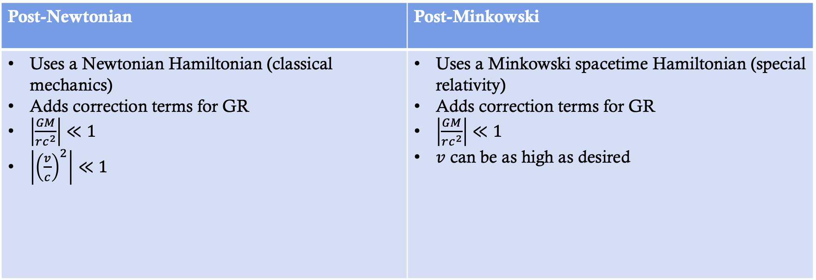
Post-Minkowski Approximation
Post-Newtonian | Post-Minkowski
Uses a Newtonian Hamiltonian (classical mechanics) Adds correction terms for GR $\left|\frac{GM}{rc^{2}}\right|≪1$ $\left|{\left(\frac{v}{c}\right)}^{2}\right|≪1$ | Uses a Minkowski spacetime Hamiltonian (special relativity) Adds correction terms for GR $\left|\frac{GM}{rc^{2}}\right|≪1$ $v$ can be as high as desired
Notes:
The Post-Newtonian is most popular and has been worked on the longest. This takes a Hamiltonian for classical Newtonian gravity and adds general relativistic correction terms.
Approximates the full equations of general relativity.
Too many words. They won’t listen to what you’re saying.
Do a compare/contrast between PN and PM.
Talk about what a Hamiltonian as, add another slide after this.

Slide 6
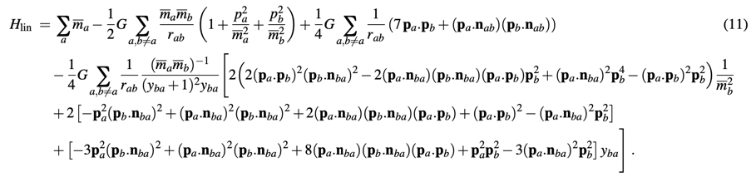
Post-Minkowski N-body Equation to First Order in G
We have written a code to solve this in equation in Julia, using their suite of advanced ODE solvers.
Notes:
PM is to second order for two-body, just n-body is only to 1st order. PN has just been worked on for longer.

Slide 7
Problem of Initial Conditions
Correct initial conditions will produce a circular orbit. The example shown here is the animation of the orbital paths of two bodies with a mass ratio of 2.
What it should look like
What the code was producing
Notes:
This is just a test to make sure the code is accurate; not all that interesting as a result.
Could be numerical error; we do convergence tests and increase step size of the solver to check this.
Could be that the code doesn’t match the equation in the paper; we’ve quadruple checked this.
Could be we don’t have the correct way to calculate initial conditions; we’ve found four separate ways to calculate initial conditions for a binary PM system to first order that all agree.
Could be that the equations in the paper are wrong; we’re in the process of checking that now.
Concisely talk about each possible explanation and how we would check it.

Slide 8
Kozai-Lidov Mechanism
Notes:
The Kozai-Lidov Mechanism occurs in hierarchical three body systems, where the two orbits exchange energy and the eccentricity and mutual inclinations of the orbits will oscillate.
Past papers using the PN approximation have noted that relativistic corrections seem to dampen the Kozai-Lidov oscillations; we wanted to test the with the PM approximation and moving the bodies closer together to see more extreme relativistic effects.
Potential changes to the KL mechanism could lead to dynamical capture; relativistics corrections tend to make things less stable which is better for collisions and dynamical capture.

Slide 9
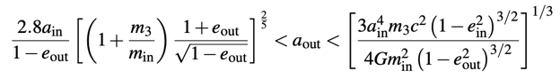
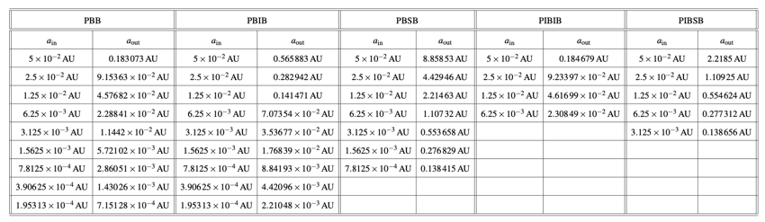
Initial Conditions
Notes:
In order to have a stable hierarchical triple system the ratio of outer semimajor axis to inner semimajor axis cannot be too small, but in order to see the KL effect it cannot be too large. The equation shows the conditions that must be met for stable orbits with the KL effect.
Explain the nomenclature for the different systems.
We started each system close to around 0.1 AU for the inner semimajor axis, then cut that in half and calculated the smallest possible outer semimajor axis in order to see the strongest relativistic effects.
The table shows some of the systems we ran; each was run for four different sets of initial orbital parameters, two that were initially circular orbits and two that were initially eccentric orbits. Holes are where systems became too close to be stable when halved again.

Slide 10
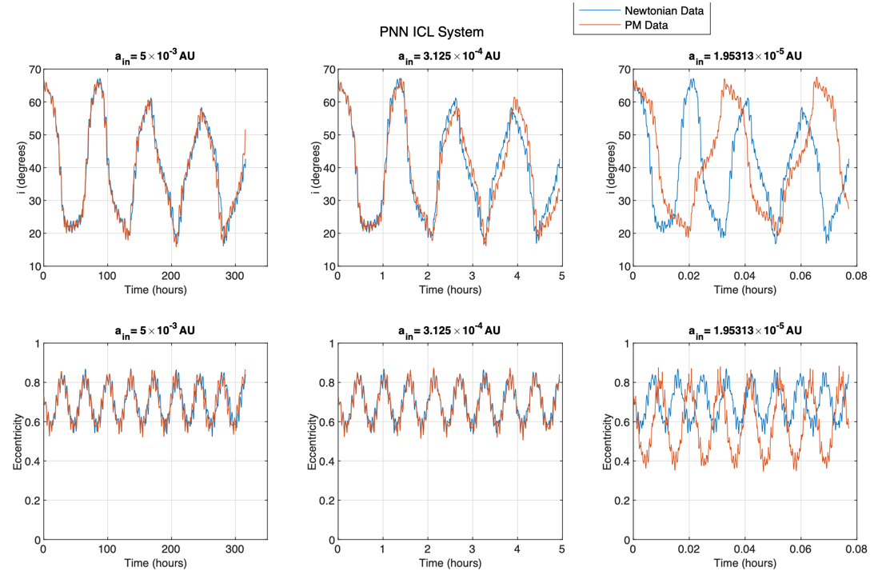
Notes:
Comment on results from this system; amplitude of eccentricity oscillations increases drastically.
Time-scale changes and oscillations move out of phase

Slide 11
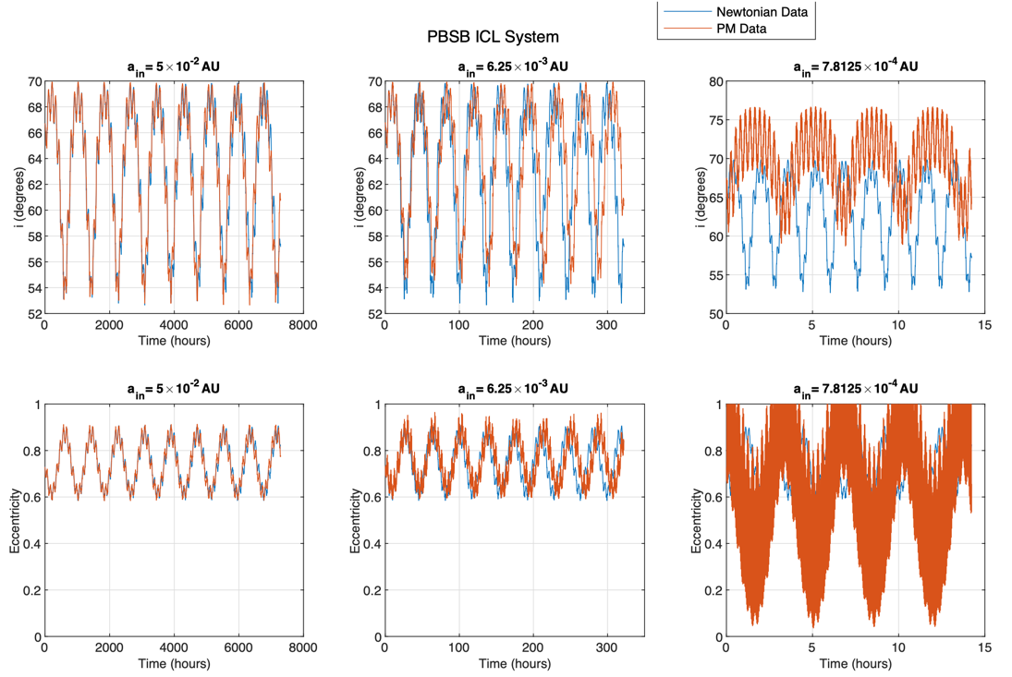
Notes:
Results shown are not entirely physical; many oscillations are an artifact introduced by the nature of the system. Needs to average over an orbital period.
Extremely drastic changes for closer orbits here; could indicate higher chance of dynamical processes in this region.

Slide 12
Newtonian VS. Post-Minkowskian
Notes:
Both are PNN_ICL systems started with the same initial conditions
Left is Newtonian, right is PM

Slide 13
Conclusion
“Mystery” black holes are being detected with large masses; could come from dynamical capture.
We used an approximation to GR to numerically simulate three-body systems and study their dynamical nature.
Relativity seems to induce higher amplitude Kozai-Lidov oscillations at closer distances, leading to higher chances of collisions and chaotic behavior.
Notes:
Make a bullet list of three or four most important points. The system shown is a PBIB system.

